Slide 1
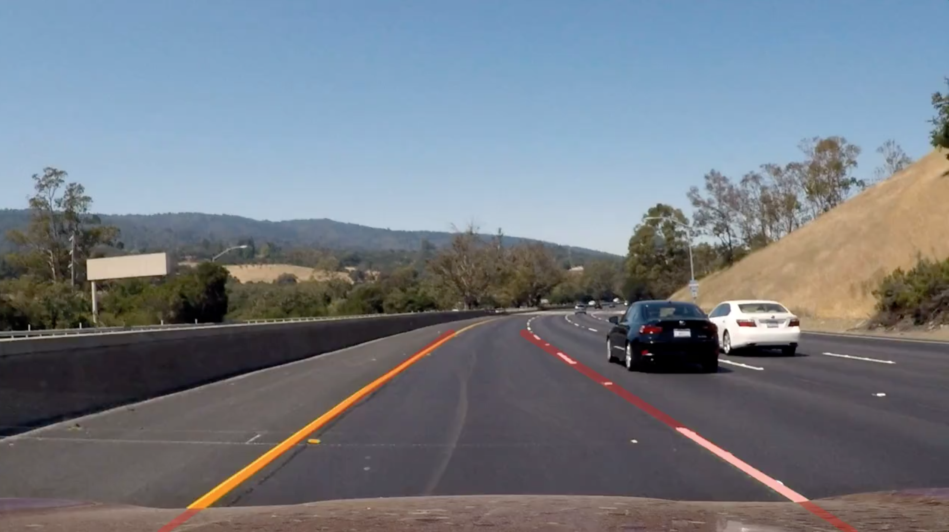
Project: Autonomous navigation on road
<number>
Team 8:
Vipul Kumbhar
Harsh Patel
Shubham Shaurya
Vishwas Powar
AuE 8240 Spring 2020
Notes:
Shaurya
<number>

Slide 2
Tasks
Autonomous lane keeping: Autonomously track the lane clockwise using a camera and one laptop.
Recognize road signs: Autonomously recognize a stop sign and a school zone sign using a camera and a second computer.
Communications: Send the road sign information from the second computer to the first computer through Wi-Fi communications.
Vehicle controls HMI: Design appropriate HMI to intuitively display control commands (e.g., STOP, SLOW DOWN) in the image at stop sign and school zone sign in the 1st program.
AuE 8240 Spring 2020
<number>
Notes:
Shaurya
<number>

Slide 3
1. Autonomous lane keeping
To detect and draw identifies lane lines, the methodology consists of steps:
Computation of camera calibration matrix and distortion coefficients from a set of chessboard images
Distortion removal on images
Application of gradient thresholds to focus on lane lines
Production of a bird’s eye view image via perspective transform
Use of sliding windows to identify lane line pixels
Fitting of second-degree polynomials to identify left and right lines composing the lane
Computation of lane center line
Warping and drawing of lane boundaries on image as well as control information
AuE 881 Fall 2018
<number>
Notes:
Vipul
<number>

Slide 4
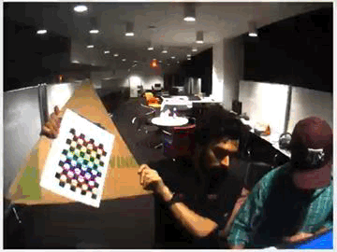
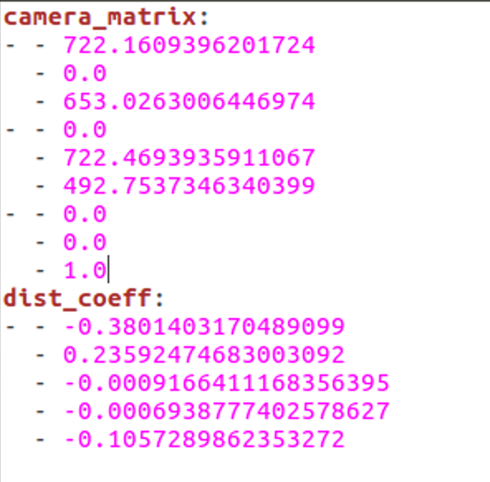
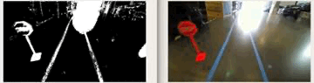
1. Autonomous lane keeping
Computation of camera calibration matrix and distortion coefficients from a set of chessboard images and distortion removal.
Application of gradient thresholds to focus on lane lines
AuE 881 Fall 2018
<number>
Notes:
Vipul
<number>

Slide 5
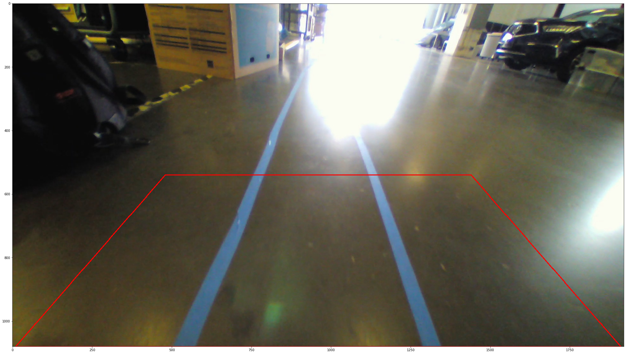
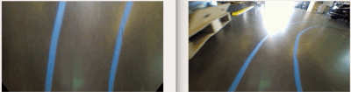
1. Autonomous lane keeping
Perspective transform
- Production of a bird’s eye view image via perspective transform
AuE 881 Fall 2018
<number>
Notes:
Vipul
<number>

Slide 6
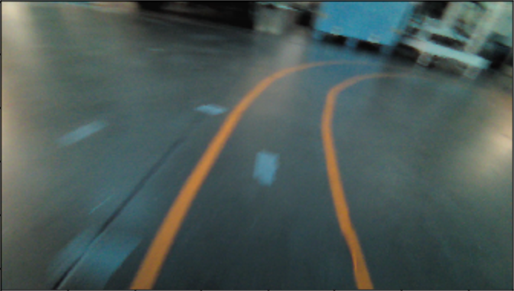
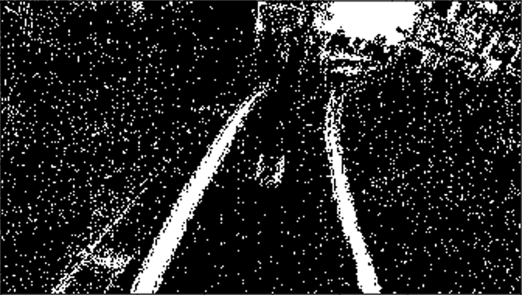
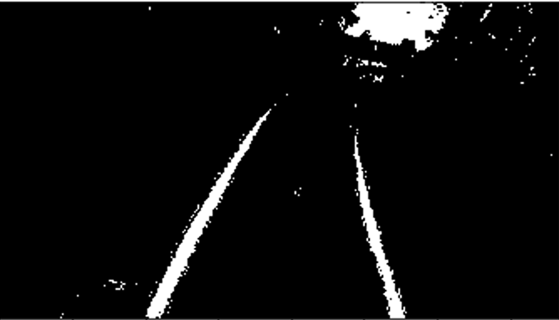
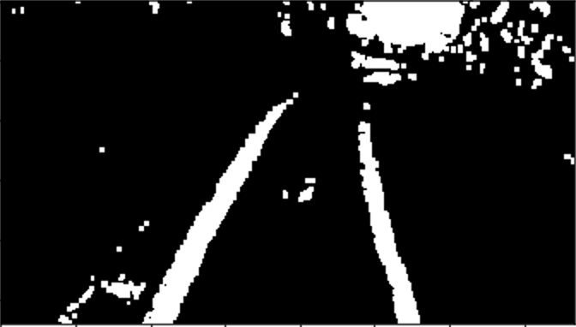
1. Autonomous lane keeping
Erode and dilute to remove noise from gradient image
Original
Binary image
Erode
Dilute
AuE 881 Fall 2018
<number>
Notes:
Vipul
<number>

Slide 7
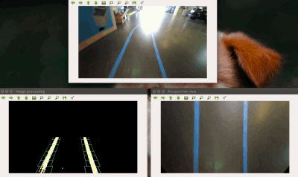
1. Autonomous lane keeping
Use of sliding windows to identify lane line pixels and fitting of second-degree polynomials to identify left and right lines composing the lane
AuE 881 Fall 2018
<number>
Notes:
Vipul
<number>

Slide 8
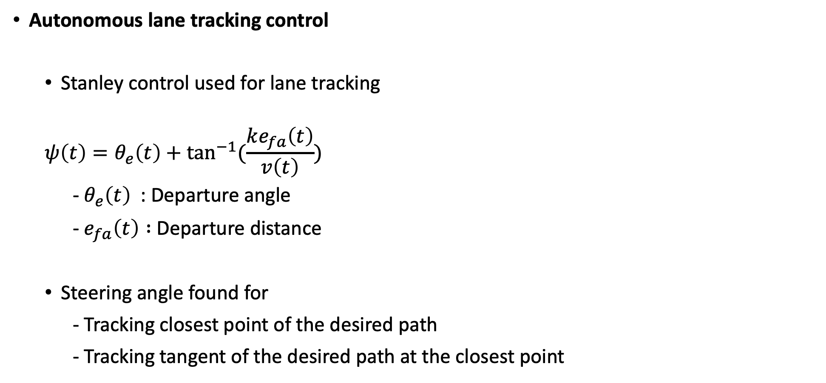
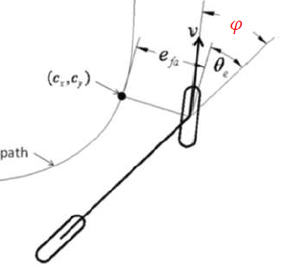
1. Autonomous lane keeping
Autonomous lane tracking control
Stanley control used for lane tracking
- : Departure angle
- Departure distance
Steering angle found for
- Tracking closest point of the desired path
- Tracking tangent of the desired path at the closest point
AuE 881 Fall 2018
<number>
Notes:
Shaurya, add how we implemented it in code
<number>

Slide 9
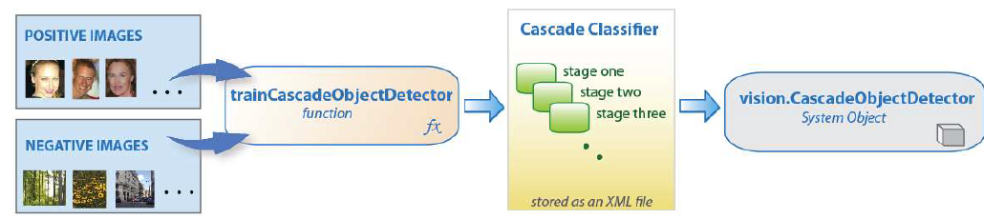
2. Recognize road signs
To detect and identify traffic signs:
Road sign recognition done using traditional machine learning-cascade object detector
Positive and negative images of school sign and stop sign provided for training
Label:
- Positive-Classifier passes region to next stage
- Negative-Classification of region is complete, detector passes to next location
Detector:
- Reports an object found at current location when final stage classifies as positive
AuE 881 Fall 2018
<number>
Notes:
Harsh
<number>

Slide 10
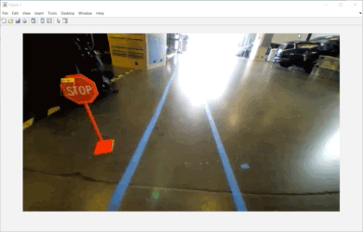
2. Recognize road signs
AuE 881 Fall 2018
<number>
Notes:
Harsh
<number>

Slide 11
3. Communications
Communication setup
WiFi communication
Stop/Slow
down
Sign recognition
Lane detection
Frame i
Frame advance (i+1)
Controls
Frame i
Steering angle
Speed
Computer 2
Computer 1
AuE 881 Fall 2018
<number>
Notes:
Harsh
<number>

Slide 12
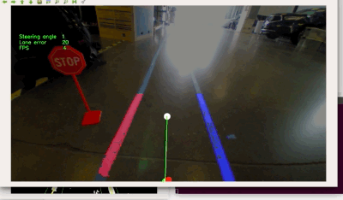
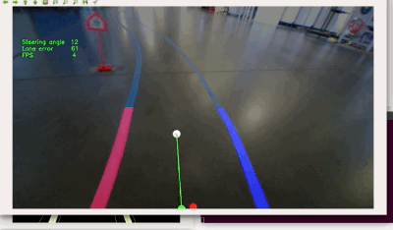
4. Vehicle controls HMI
Display the steering angle according to the lane tracking control using Stanley controller
Display whether sign detected and what sign is detected (Stop or school sign)
AuE 881 Fall 2018
<number>
Notes:
Vishwas
<number>

Slide 13
Challenges and achievements
Challenges / solution
FPS (resolution) - Changed input image resolution
False negatives /Datasets - Created new datasets based on false positives
Communication - UDP fails without any cause
Result verification - Lack of closed loop feedback system for controls
Achievements
Python (Lane keeping) – MATLAB (Sign recognition) communication /integration
Successful implementation of polyfit lines
~ 100% lane detection rate
AuE 881 Fall 2018
<number>
Notes:
Either Vipul or whoever can explain this
<number>

Slide 14
Questions?
AuE 881 Fall 2018
<number>

Slide 15
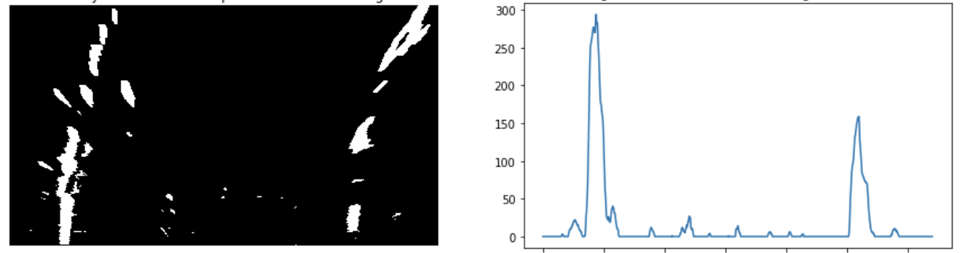
Backup slide 1
First box identification from histogram
AuE 881 Fall 2018
<number>
Notes:
<number>

